Slide 1
Detecting Cracks in Concrete Structures Using Adaptive Thresholding for Image Segmentation
Caleb Yearsley
CS 6680
Final Project

Slide 2
Desired Outcomes
Desired Outcomes:
“Improved Simplified Novel Method for Edge Detection in Grayscale Images Using Adaptive Thresholding”
Improve the simplified adaptive thresholding technique
Expand on the adaptive thresholding technique, such that it works well with detecting cracks in concrete structures

Slide 3
Related Methods (categories)
The adaptive thresholding technique is related to gradient operators (e.g Prewitt or Sobel)
Is a first order derivative of the gradient operator
Adaptive thresholding is based on similarity detection

Slide 4
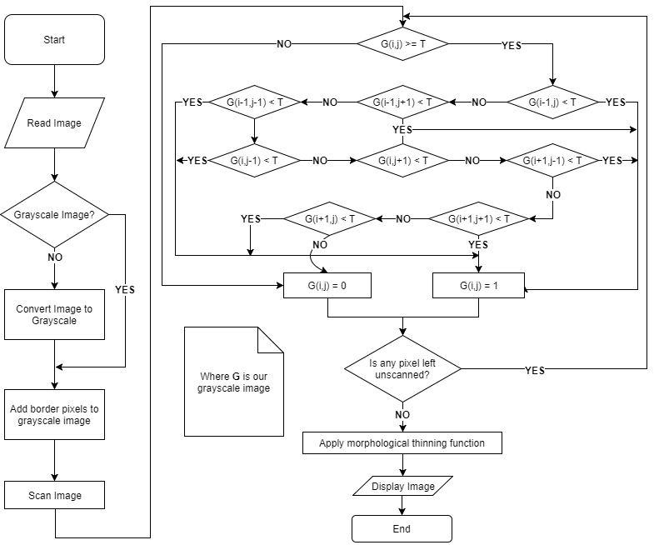
The Proposed Approach
The proposed method uses a 3x3 mask.
Authors state that this method reduces the amount of noise.

Slide 5
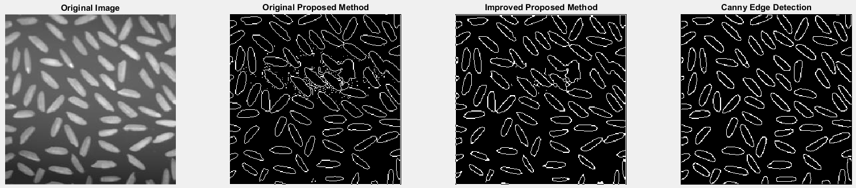
Generic Method Comparison

Slide 6
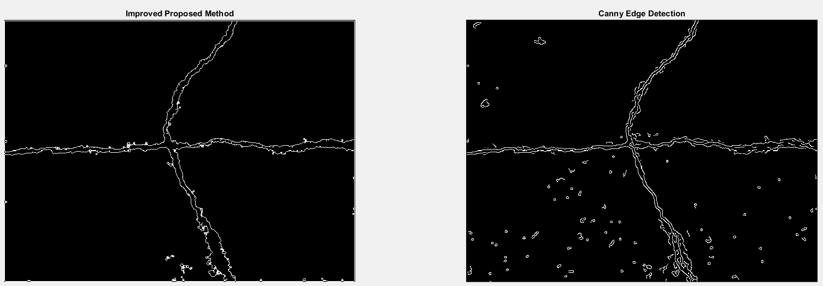
Generic Method Comparison
Modified thresholds until entire crack was visible

